Slide 1
Operators in Java
https://docs.oracle.com/javase/tutorial/java///nutsandbolts/operators.html

Slide 2
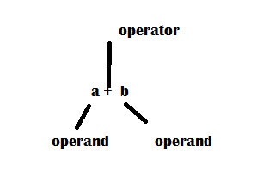
Operators
An operator is a symbol that performs an operation.
An operator acts on some variable or data called operands.
Single variable unary operator
Two operands binary operator
Three operands ternary operator

Slide 3
Arithmetic Operators
There are various arithmetic operators used in Java:
Operator Meaning Work
+ Addition To add two operands.
- Subtraction To subtract two operands.
* Multiplication To multiply two operands.
/ Division To divide two operands.
% Modulus To get the area of the division of two operands.
Arithmetic operators are applied on integer and floating-point and not on boolean types. But you can use them on the characters' because, in Java, Char is sub-set of the integer.

Slide 4
Modulus
package com.ravi.org;
public class Example {
public static void main(String args[])
{
int iValue = 101;
double dValue = 39.02;
System.out.println(iValue + " mod 9 = " + iValue % 9);
System.out.println(dValue + " mod 9 = " + dValue % 9);
//float f=5;
//System.out.println(f%2.5);
}
}

Slide 5
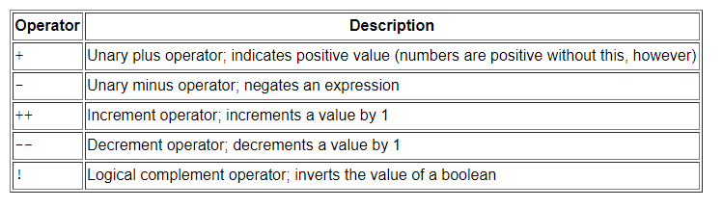
Unary operators
The unary operators require only one operand; they perform various operations such as incrementing/decrementing a value by one, negating an expression, or inverting the value of a boolean.

Slide 6
The Equality and Relational Operators
The equality and relational operators determine if one operand is greater than, less than, equal to, or not equal to another operand. The majority of these operators will probably look familiar to you as well. Keep in mind that you must use "==", not "=", when testing if two primitive values are equal.
== equal to
!= not equal to
> greater than
>= greater than or equal to
< less than
<= less than or equal to

Slide 7
Logical Operators are used to construct compound conditions. Compound condition is combination of several simpler condition
Operator | Name | Description | Example
&& | Logical and | Returns true if both statements are true | x < 5 && x < 10
|| | Logical or | Returns true if one of the statements is true | x < 5 || x < 4
! | Logical not | Reverse the result, returns false if the result is true | !(x < 5 && x < 10)

Slide 8
Boolean operators
public class Test {
public static void main(String args[]) {
boolean a = true;
boolean b = false;
System.out.println("a && b = " + (a&&b));
System.out.println("a || b = " + (a||b) );
System.out.println("!(a && b) = " + !(a && b));
}
}

Slide 9
Bit wise operators
These operators act on individual bits(0 and 1) of operands.
They acts on integer data types only.
Operators | Meaning of operators
& | Bitwise AND
| | Bitwise OR
^ | Bitwise XOR
~ | Bitwise complement
<< | Shift left
>> | Shift right
>>> | Zero fill shift right operator.

Slide 10
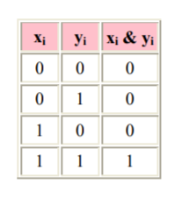
Bitwise AND operator & The output of bitwise AND is 1 if the corresponding bits of two operands is 1. If either bit of an operand is 0, the result of corresponding bit is evaluated to 0
Let us suppose the bitwise AND operation of two integers 12 and 25.
12 = 00001100 (In Binary)
25 = 00011001 (In Binary)
Bit Operation of 12 and 25
00001100
& 00011001
________
00001000 = 8 (In decimal)

Slide 11
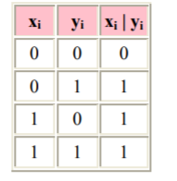
Bitwise OR operator |
The output of bitwise OR is 1 if at least one corresponding bit of two operands is 1. In C Programming, bitwise OR operator is denoted by |.
12 = 00001100 (In Binary)
25 = 00011001 (In Binary)
Bitwise OR Operation of 12 and 25
00001100
| 00011001
________
00011101 = 29 (In decimal)

Slide 12
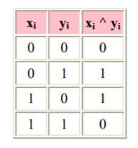
Bitwise XOR (exclusive OR) operator ^
The result of bitwise XOR operator is 1 if the corresponding bits of two operands are opposite. It is denoted by ^.
12 = 00001100 (In Binary)
25 = 00011001 (In Binary)
Bitwise XOR Operation of 12 and 25
00001100
^ 00011001
________
00010101 = 21 (In decimal)

Slide 13
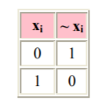
Bitwise complement operator ~
Bitwise compliment operator is an unary operator (works on only one operand). It changes 1 to 0 and 0 to 1. It is denoted by ~.
35 = 00100011 (In Binary)
Bitwise complement Operation of 35
~ 00100011
________
11011100 = 220 (In decimal)

Slide 14
Twist in bitwise complement operator in C Programming
The bitwise complement of 35 (~35) is -36 instead of 220, but why?
For any integer n, bitwise complement of n will be -(n+1). To understand this, you should have the knowledge of 2's complement.

Slide 15
2's Complement
Two's complement is an operation on binary numbers. The 2's complement of a number is equal to the complement of that number plus 1. For example:
Decimal Binary 2's complement
0 00000000 -(11111111+1) = -00000000 = -0(decimal)
1 00000001 -(11111110+1) = -11111111 = -256(decimal)
12 00001100 -(11110011+1) = -11110100 = -244(decimal)
220 11011100 -(00100011+1) = -00100100 = -36(decimal)
Note: Overflow is ignored while computing 2's complement.
The bitwise complement of 35 is 220 (in decimal). The 2's complement of 220 is -36. Hence, the output is -36 instead of 220.

Slide 16
Bitwise complement of any number N is -(N+1). Here's how:
bitwise complement of N = ~N (represented in 2's complement form)
2'complement of ~N= -(~(~N)+1) = -(N+1)

Slide 17
Bit wise Shift Operators in java programming
There are three shift operators in java programming:
Left shift operator(<<).
Right shift operator(>>)
Zero fill Right shift operator.(>>>)

Slide 18
Right Shift Operator
Right shift operator shifts all bits towards right by certain number of specified bits. It is denoted by >>.
212 = 11010100 (In binary)
212>>2 = 00110101 (In binary) [Right shift by two bits]
212>>7 = 00000001 (In binary)
212>>8 = 00000000
212>>0 = 11010100 (No Shift)

Slide 19
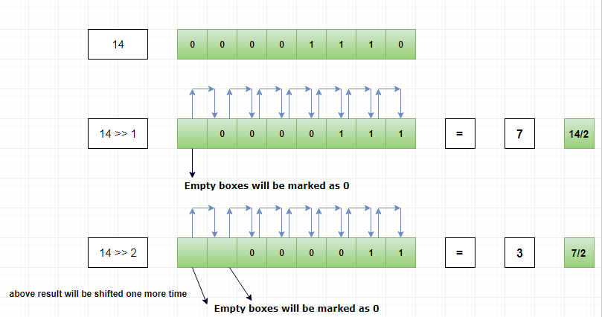
Diagrammatic Representation

Slide 20
Application of Bitwise Right Shift Operator
In the above diagram, you can notice that whenever we shift the number one position to right, the output value will be exactly number / 2.
If I shift 14 by 1 position to the right, output will be 14 / 2 = 7. i.e 14/2 = 7
If I shift 14 by 2 position to the right, output will be 14 / 4 = 3. i.e 14/4 =3.5 since it’s an integer, fractional part will not be considered.
In general, if we shift a number by n times to right, the output will be number / (2^{n}) .

Slide 21
Example
Let’s assume number as 128.
If we shift the number 5 position to the right, the output will be
= 128 >> 5
= 128 / (2⁵)
=128/32
=4.

Slide 22
Left Shift Operator
Left shift operator shifts all bits towards left by certain number of specified bits. It is denoted by <<.
212 = 11010100 (In binary)
212<<1 = 110101000 (In binary) [Left shift by one bit]
212<<0 =11010100 (Shift by 0)
212<<4 = 110101000000 (In binary) =3392(In decimal)

Slide 23
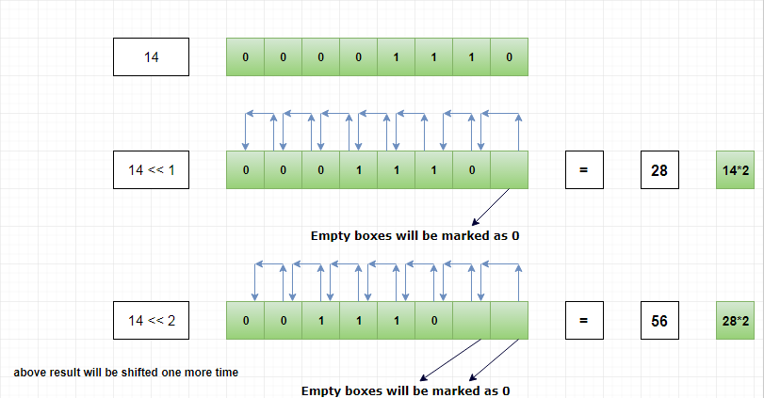
Diagrammatic left shift operator

Slide 24
Application of Bitwise Left Shift Operator
In the above diagram, you can notice that whenever we shift the number one position to left, the output value will be exactly number * 2.
If we shift 14 by 1 position to the left, output will be 14 * 2 = 28.
If we shift 14 by 2 position to the left, output will be 14 * 4 = 56.
In general, if we shift a number by n position to left, the output will be number * (2^{n}).

Slide 25
Example
Let’s assume the number as 12
If we shift the number 3 position to the left.
Then the output will be,
Example
12 << 3
= 12 * (2power3)
= 12 * 8
= 96.

Slide 26
Zero fill Right shift operator
This operator also shifts the bits of the number towards right a specified number of positions.
But it stores 0 in sign bit.
Since it always fills 0 in the sign bit it is called Zero fill Right shift operator.
If we apply >>> on a positive number it gives same output as >>. But in case of negative numbers, the output will be positive, since sign bit is replaced by a 0.
https://www.geeksforgeeks.org/bitwise-shift-operators-in-java/

Slide 27
Interview question
What is the difference between >> and >>> ?
Both bitwise right shift operator(>>) and bitwise zero fill shift operator(>>>) are used to shift bits towards right. The difference is that >> will protect the sign bit where as the >>> operator will not protect the sign bit. It always fills with 0 in sign bit.

Slide 28
Member Operator(.)
Member operator also called as dot operator.
It symbol is a .(dot or period)
This operator tells about a member of a package or a class.
EX :
package.classname-→ java.lang.String
Classname.variable.

Slide 29
Instanceof operator
This operator is used to test if an object belongs to a class or not.
Instance means object.
We can also check if an object belongs to an interface or not.
Syntax :
boolean variable= object instanceof class;
boolean variable= object instanceof interface;

Slide 30
Sample program
package com.ravi.org;
public class Instanceof_Check {
int a=10;
public static void main(String[] args) {
// TODO Auto-generated method stub
Instanceof_Check ic= new Instanceof_Check();
//Instanceof_Check ic= null;
boolean b = ic instanceof Instanceof_Check;
System.out.println(b);
if(ic instanceof Instanceof_Check)
{
System.out.println(ic.a);
}
}
}

Slide 31
new operator
new operator is often used to create objects to classes. We know that objects are created on heap memory by JVM(dynamically at runtime).
Syntax:
Classname objectname= new classname();
Student s= new Student();

Slide 32
Cast operator
Cast operator is used to convert one data type into another data type. This operator can be used by writing data type inside simple braces.
double x= 10.54;
int y=x //error because of x and y are different.
int y=(int)x;

Slide 33
Priority of operators.
Operators | Precedence
postfix | expr++ expr--
unary | ++expr --expr +expr -expr ~ !
multiplicative | * / %
additive | + -
shift | << >> >>>
relational | < > <= >= instanceof
equality | == !=
bitwise AND | &
bitwise exclusive OR | ^
bitwise inclusive OR | |
logical AND | &&
logical OR | ||
ternary | ? :
assignment | = += -= *= /= %= &= ^= |= <<= >>= >>>=

Slide 34
Operators precedence and Associativity
https://www.javatpoint.com/associativity-of-operators-in-java#:~:text=Precedence%20and%20associativity%20are%20two%20features%20of%20Java,%28%2A%29%20operator%20is%20executed%20first%2C%20followed%20by%20addition.

